Slide 1
NHL Goal
Prediction
Does spatial deep learning outperform classical expected goals models?

Slide 2
The Problem
In hockey analytics, not all shots are created equal.
A shot from the slot directly in front of the net is far more dangerous than a low-percentage attempt from the blue line. Quantifying that difference is the foundation of expected goals (xG) modeling.
The core question:
Can a CNN that explicitly models spatial structure on the ice outperform classical approaches that rely on engineered features like distance and angle?
Github Link
Does where
you shoot
matter more
than how
you shoot?

Slide 3
Three Models, One Question
Each model adds capacity. The question is whether that capacity translates to better predictions.
01
02
03
Logistic Regression
MLP
Spatial CNN
Classic xG
baseline
Tabular nonlinear
model
Grid-based
rink representation
Distance + angle only. Linear relationship assumed. Surprisingly strong.
Same features, more capacity. Can it learn distance × angle interactions?
Treat the ice as an image. Let the network learn scoring geometry directly.

Slide 4
The Data
528,720
7%
2
shot attempts
2020–2025 seasons
goal rate
significant class imbalance
core features
distance + angle
Key preprocessing decisions
Shot direction normalized
All attacks toward the same goal; essential for CNN spatial consistency
Class-weighted loss
Compensates for 7% goal rate without oversampling
Time-based split
Train: 2020–2024 | Test: 2024–2025 season
StandardScaler
Applied to LR and MLP features | CNN uses raw grid coordinates

Slide 5
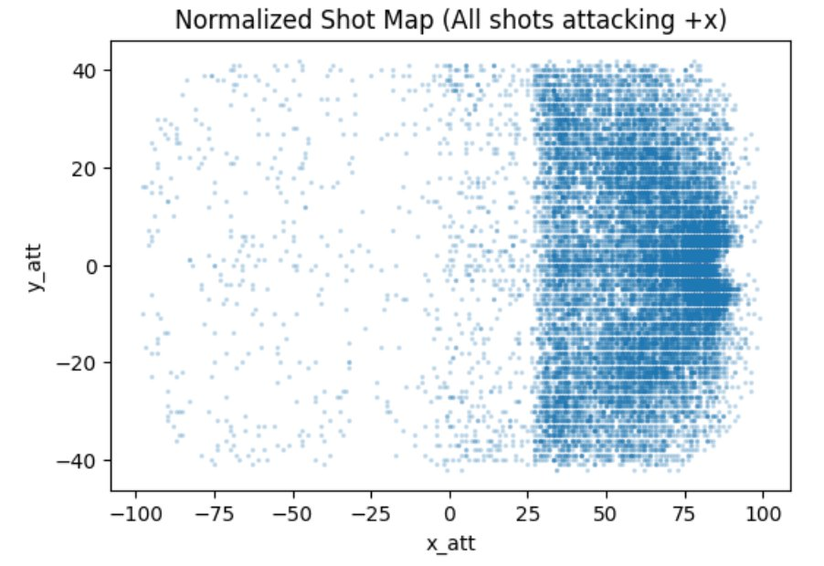
EDA
Normalized shot map (all attacks → +x)
528,720
total shot attempts
7%
goal rate · strong class imbalance
The dense concentration in the offensive zone confirms that shot location is highly structured — not random across the ice. The normalization step (all attacks toward +x) is what makes CNN spatial learning possible.

Slide 6
Logistic Regression
The Baseline
0.709
0.143
Features: distance + angle only
Assumes linear log-odds relationship
No feature interactions
Treats rink as feature space, not geometry
ROC-AUC
PR-AUC
Interpretation
ROC-AUC of 0.709 is surprisingly strong for just two features. Distance and angle already capture most of the signal in goal probability. Goals are more likely closer to the net and from central positions, and that relationship is mostly monotonic.
This makes logistic regression a hard baseline to beat. The nonlinear models need to find signals that two summary statistics missed.

Slide 7
MLP
Nonlinear Tabular Model
0.710
0.152
vs. Logistic Regression
ROC-AUC +0.001 (marginal)
PR-AUC +0.010 (meaningful)
Training cost: low
ROC-AUC
PR-AUC
Interpretation
The MLP adds nonlinear capacity over logistic regression, allowing it to model interactions between distance and angle. The modest ROC-AUC gain (+0.001) suggests the linear assumption wasn't far off for ranking shots.
The PR-AUC gain (+0.010) is more meaningful; under class imbalance, better precision on the positive class matters. But the feature space is still limited to two engineered variables. The MLP doesn't explicitly use spatial structure.

Slide 8
Spatial CNN:
3-Channel CNN Success
1-Channel CNN — ROC-AUC: 0.658
3-Channel CNN — ROC-AUC: 0.715
Single spatial grid encoding shot frequency. Underperformed logistic regression.
Why this failed: one channel can't separate where shots happen from where goals happen. The model learned density, not danger.
Channel 1: Shot location grid Channel 2: Distance map Channel 3: Angle map Each layer adds a different spatial signal. Now the network can learn danger, not just density.
The lesson: model performance is not just about depth or complexity.
The architecture was the same. The representation changed. That was enough to flip the CNN from worst performer to best. Input encoding matters as much as model capacity.

Slide 9
Hyperparameter Tuning
Learning Rate
ROC-AUC: 0.715 → 0.717
More stable gradient updates. Biggest single improvement.
1e-3 → 5e-4
✓ Meaningful gain
Model Depth
ROC-AUC: 0.715 → 0.716
Shot danger is spatially smooth. More layers don't help a simple geometry problem.
Baseline → Deeper arch
— Marginal
Dropout
ROC-AUC improved, PR-AUC didn't
Less regularization helped ROC-AUC but hurt precision on the positive class.
0.4 → 0.3
— Mixed
Final model: lr=5e-4, dropout=0.4, baseline depth — best PR-AUC, stable training.

Slide 10
Model Comparison
Model
ROC-AUC
PR-AUC
Training Cost
Logistic Regression
0.709
0.143
Very Low
MLP (Tabular)
0.710
0.152
Low
CNN (3-channel)
0.718
0.152
Moderate
Key finding
Spatial CNN
PR-AUC is the right metric. With 7% goal rate, precision on the positive class matters more than overall ranking.
Best PR-AUC, but only once representation was fixed. The 1-channel version was the worst model.

Slide 11
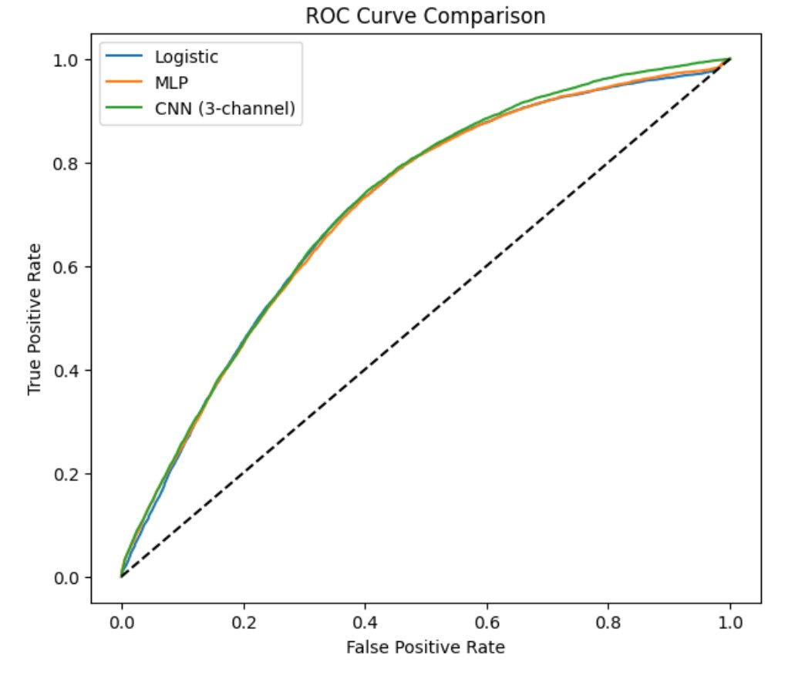
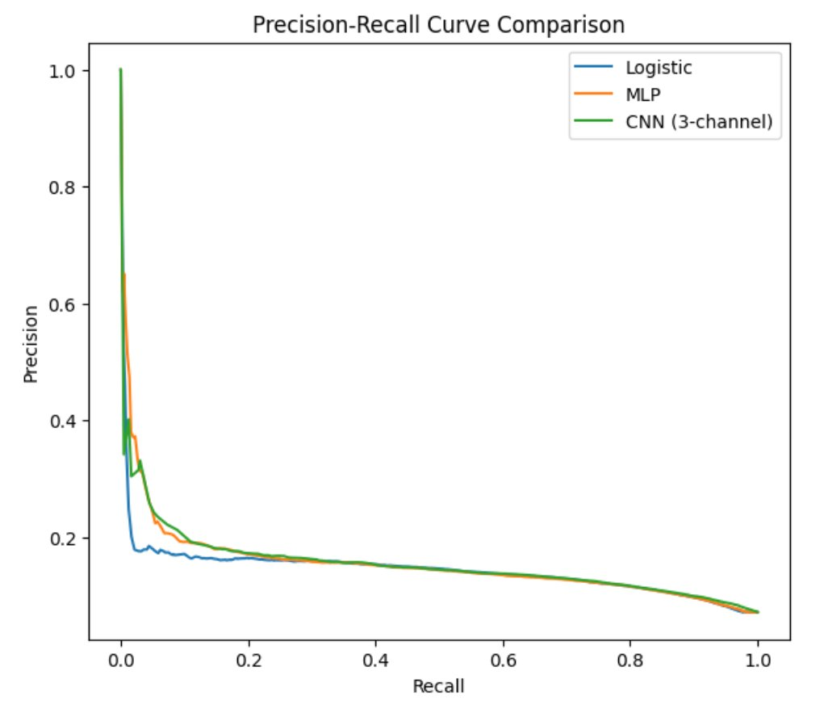
Model Comparison: Results
ROC Curve
Precision-Recall Curve (more informative under 7% imbalance)
ROC curves are nearly overlapping. All three models rank shots similarly. The PR curve is where the CNN earns its edge: higher precision at low recall means fewer false alarms on high-confidence goal predictions.

Slide 12
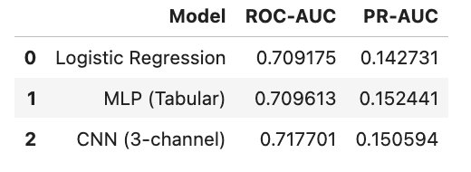
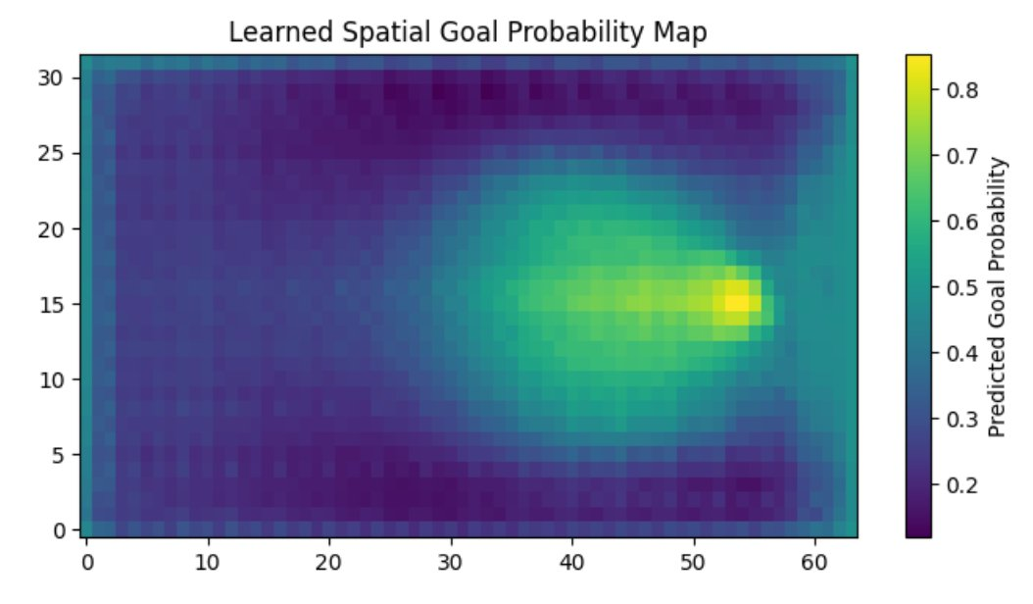
Final Results
Final model scores
Learned spatial goal probability map
+1.3%
+5.5%
0.658
ROC-AUC gain
LR → CNN
PR-AUC gain
LR → MLP
1-ch CNN
(worst model)
The CNN independently learned that the slot region (center-front) is the highest danger zone — without being told where the slot is. This validates the spatial encoding and confirms the model learned real hockey geometry.

Slide 13
Conclusions
Representation matters more than architecture.
The 1-channel CNN failed. The 3-channel CNN succeeded. Same network, different encoding. That's the most important finding.
Deep learning doesn't automatically win.
Logistic regression with two features hit ROC-AUC 0.709. The CNN needed significant work to surpass it, and the margin is modest.
Spatial structure is real and learnable.
The CNN's learned probability heatmap matches known hockey principles: slot shots are most dangerous, perimeter shots least. It found that geometry without being told.

